Slide 1
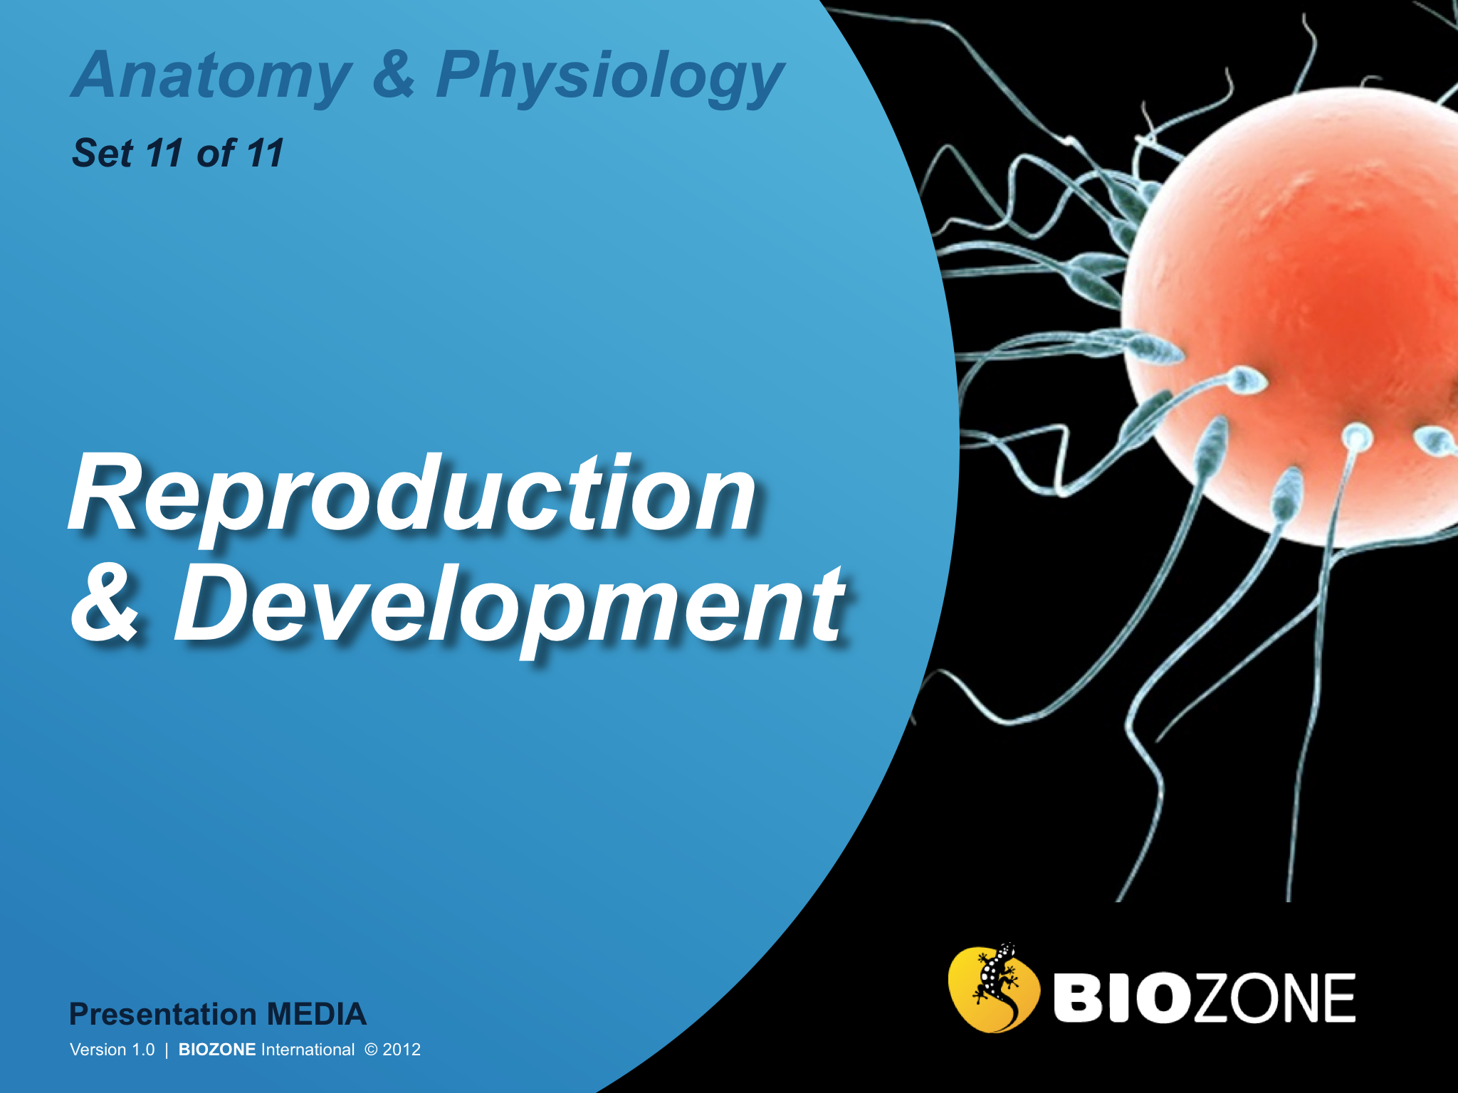

Slide 2

Introduction
  Interacting systems
  Contexts
Reproduction systems
  Female reproduction system
  Oogenesis
  Menstrual cycle
  Male reproductive system
  Spermatogenesis
Fertilization and Development
  Fertilization
  Development
  Pregnancy and the placenta
  Pregnancy testing
  Contraception
  Treating infertility
Birth
  Childbirth
  Complications
  Lactation
Growth and Development
  Growth and development
  Apoptosis
  Cancer
  Sexual development
Glossary

Slide 3
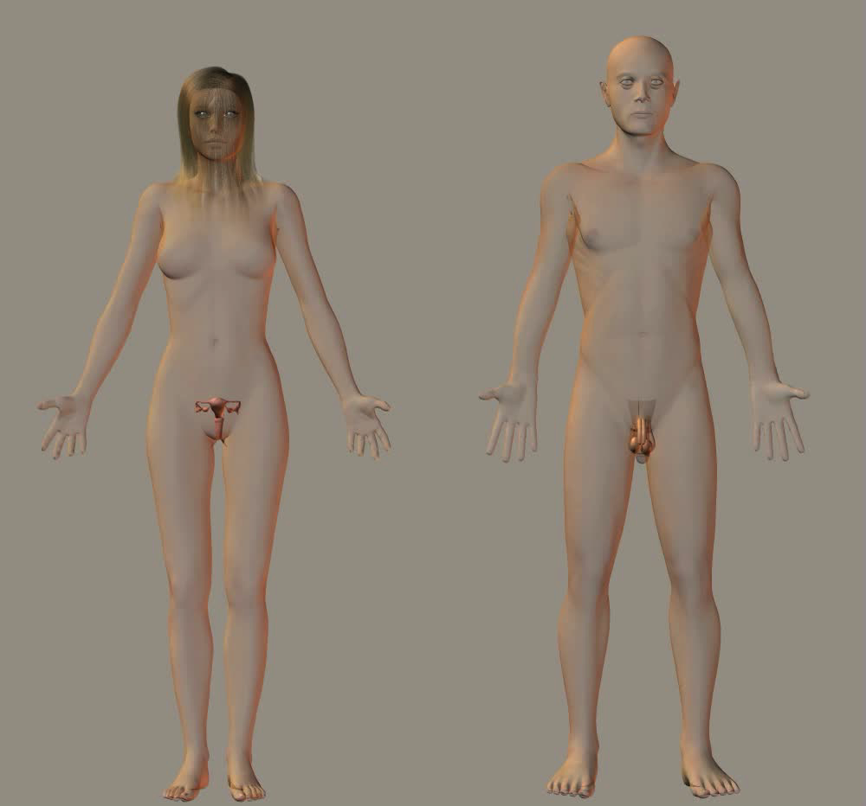
The Reproductive System
The gonads, (the primary sex organs) are the testes in males and the ovaries in females.
The reproductive role of the male is to manufacture sperm and deliver them to the female reproductive tract.
The reproductive role of the female is to produce ova (egg cells) and (after fertilization) to provide nutrient for and protect the growing fetus.

Slide 4
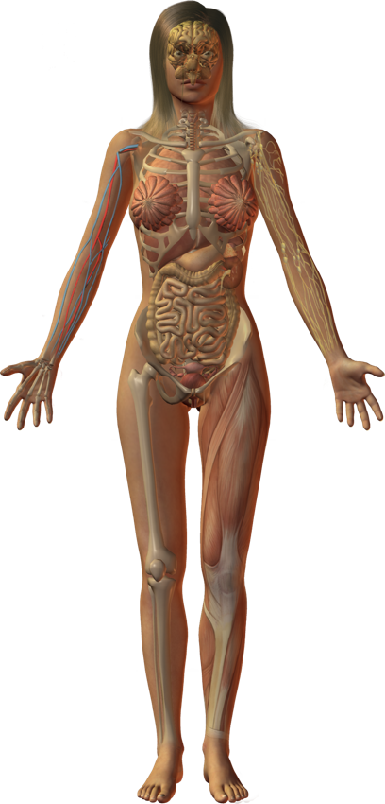
Interacting Systems
Nervous system
Endocrine system
Cardiovascular system
Lymphatic system and immunity
The reproductive system in adults is responsible for reproduction, i.e. the production of gametes and offspring.
Unlike other body systems, which are functioning almost continuously since birth, the reproductive system in quiescent until puberty, at which time it completes development and maturation.
The interactions of the reproductive system with other systems are described on the following slides.
Respiratory system
Urinary system
Digestive system
Integumentary system
Muscular system
Skeletal system

Slide 5
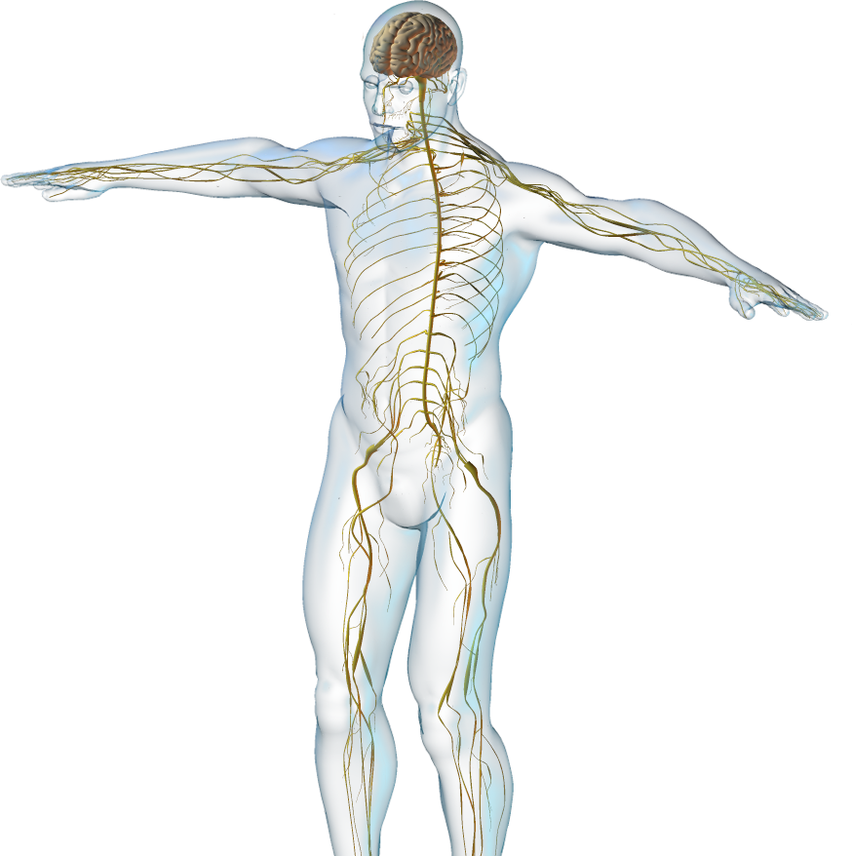
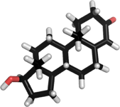
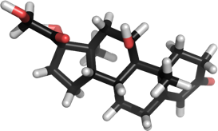
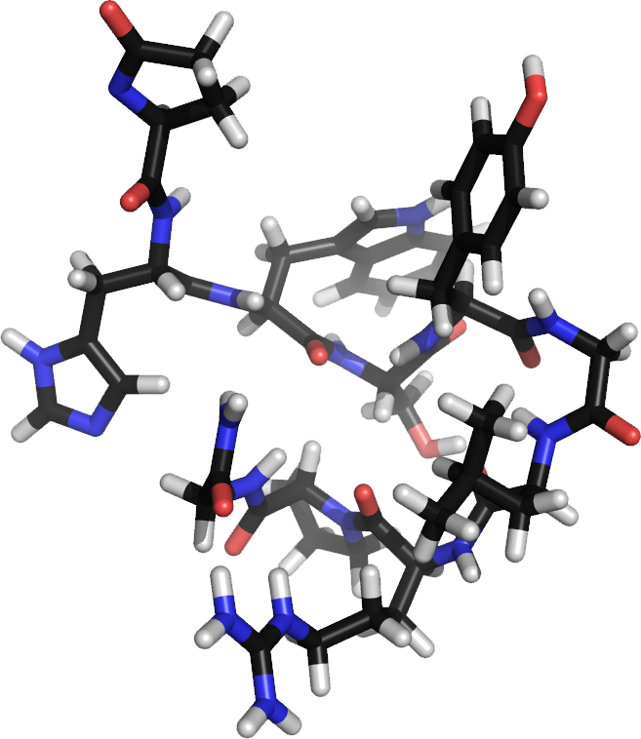
Nervous System
The reproductive system interacts with the nervous system:
  Sex hormones masculinize or feminize the brain and influence sex drive.
  The neurohormone, GnRH from the hypothalamus regulates the timing
  of puberty.
  Reflexes regulate aspects of the sexual response.
Testosterone
Estradiol
GnRH

Slide 6
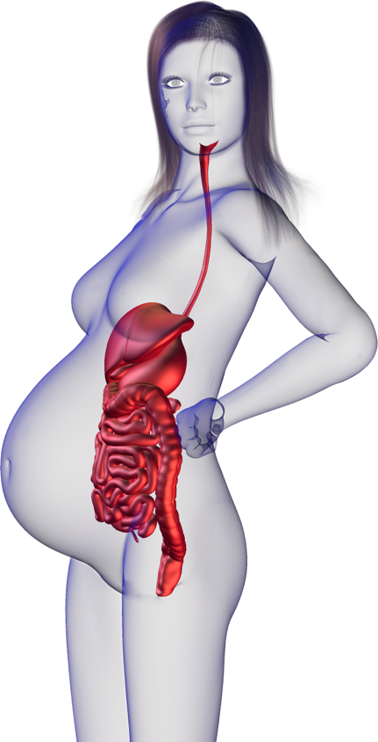
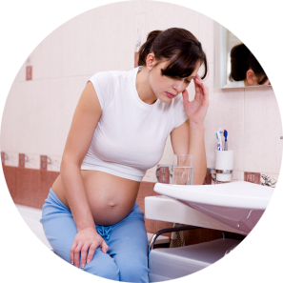

Digestive System
The reproductive system interacts with the digestive system:
  Digestive organs are crowded in late pregnancy and constipation and heart-burn are common.
  Increased hormone levels commonly result in nausea and vomiting in the first three months of pregnancy.
Istock

Slide 7
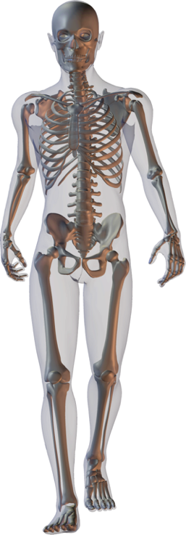
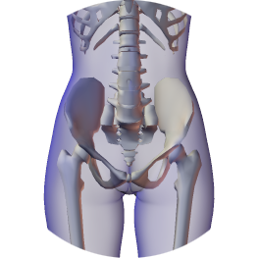
Skeletal System
The reproductive system interacts with the skeletal system:
  Sex hormones are responsible for secondary sexual characteristics associated with the skeleton:
    In males androgens masculinize the skeleton (broad shoulders and expanded chest) and increase bone density.
    In females, estrogen causes pelvic widening and maintains bone mass.
  Bony pelvis protects some reproductive organs.
Testosterone
Estradiol

Slide 8
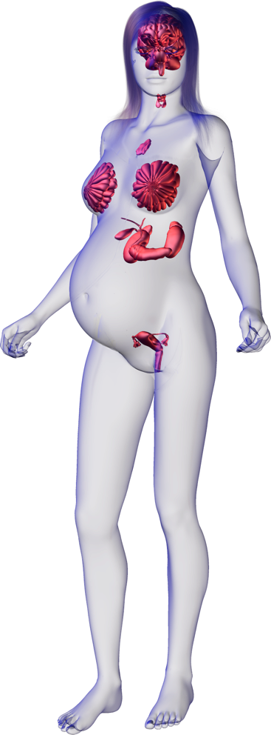
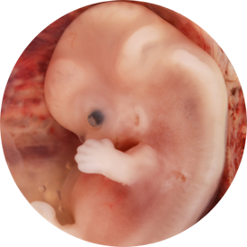
Endocrine System
The reproductive system interacts with the endocrine system:
  Reproductive hormones from the ovaries (in females) and testes (in males) are responsible for the development of secondary sexual characteristics.
    They are regulated via feedback mechanisms to the hypothalamic-pituitary axis.
  Gonadotropins (e.g. LH and FSH) help to regulate gonadal function.
  Placental hormones maintain pregnancy.
Estradiol
Testosterone
Ed Uthman

Slide 9
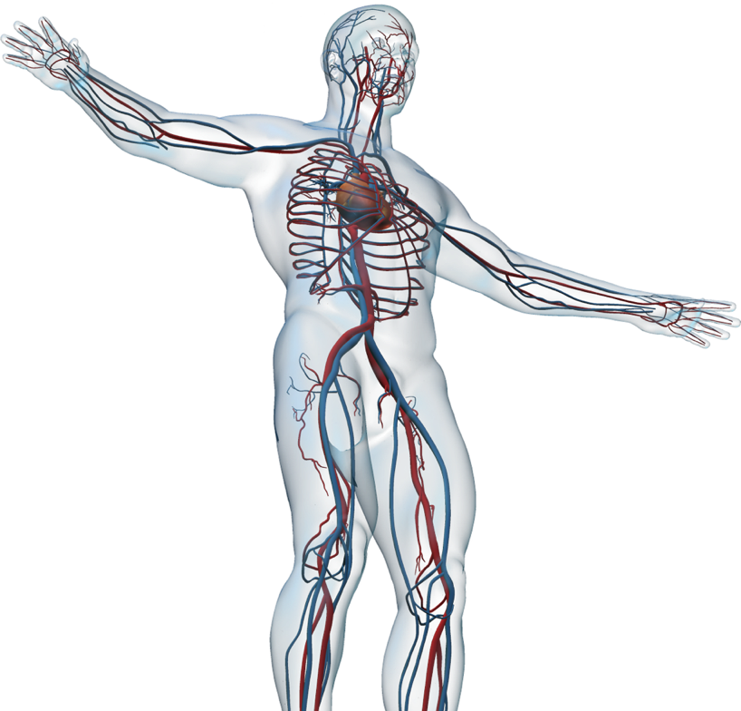
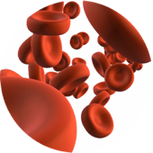
Cardiovascular System
The reproductive system interacts with the cardiovascular system:
  Estrogen increases blood HDL cholesterol levels and promotes cardiovascular health in women of reproductive age.
  Pregnancy places extra demands on the cardiovascular system.
  Blood volume increases of 40-50% during pregnancy.
  Local vasodilation is responsible for aspects of the sexual response in men and women.
  Blood transports sex hormones to target tissues.
Estradiol (an estrogen)
Istock
Testosterone

Slide 10
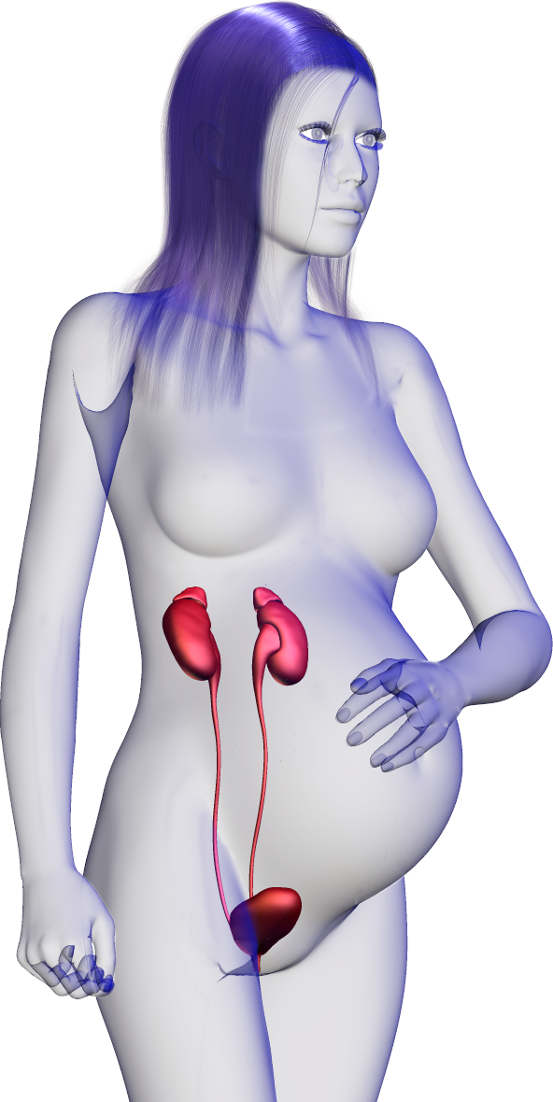



Urinary System
The reproductive system interacts with the urinary system:
  Increased frequency and urgency of urination in pregnancy as a result of pressure on the bladder and
  pelvic floor.
  Enlargement of prostate (usually in older men) can impede urination.
  Kidneys dispose of nitrogenous waste and maintain fluid and electrolyte balance of mother and fetus in pregnancy.

Slide 11
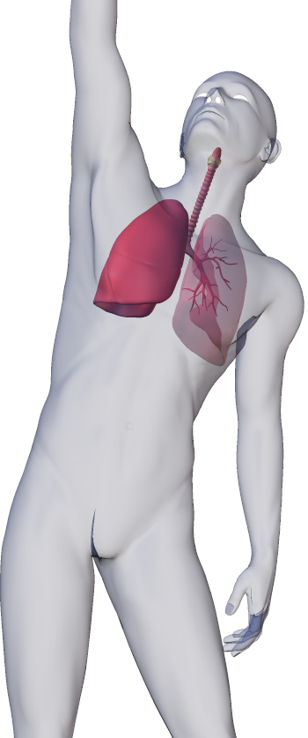
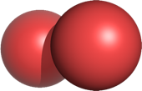
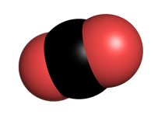
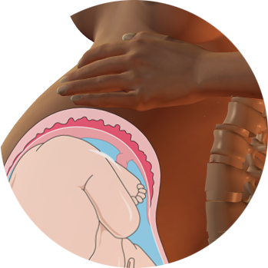
Respiratory System
The reproductive system interacts with the respiratory system:
  Respiratory system provides O2 to the reproductive system and removes CO2.
  Vital capacity and breathing rate increase during pregnancy.
    Enlarged uterus impairs the descent of the diaphragm and can cause shortness of breath late in pregnancy.
O2
CO2

Slide 12
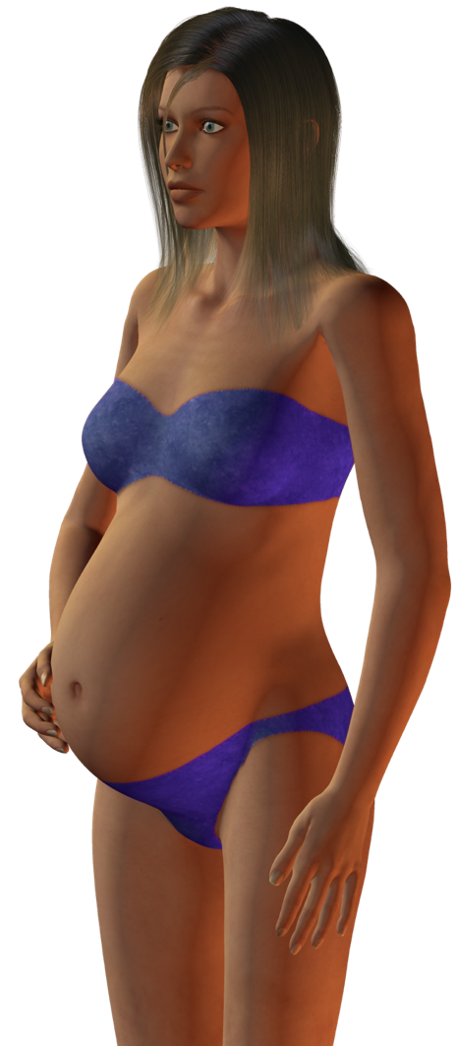
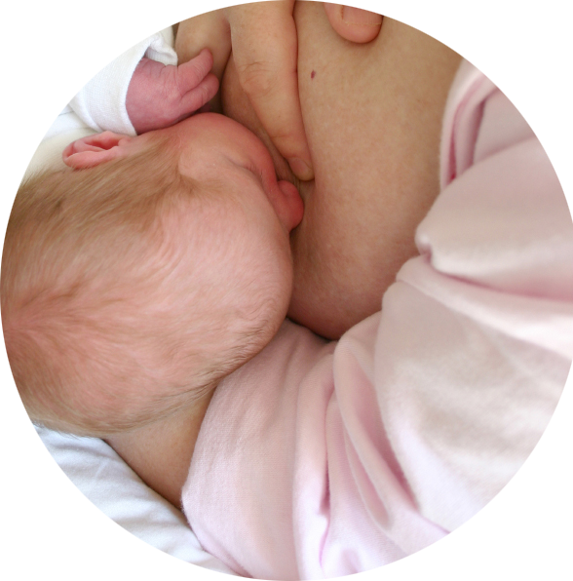

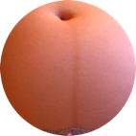
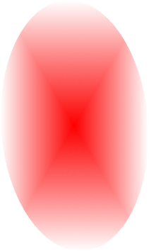
Integumentary System
The reproductive system interacts with the integumentary system:
  In lactating women, milk from the mammary glands nourishes the infant.
  Androgens activate oil glands and lubricate skin and hair.
    Estrogen increases skin hydration and increases skin pigmentation during pregnancy.
  Sex hormones are responsible for secondary sexual characteristics associated with the integument, e.g, appearance of pubic hair and changes in fat distribution associated with male and female body shapes.
Istock
Breast feeding
Estradiol
Jeremy Kemp
Linea nigra

Slide 13
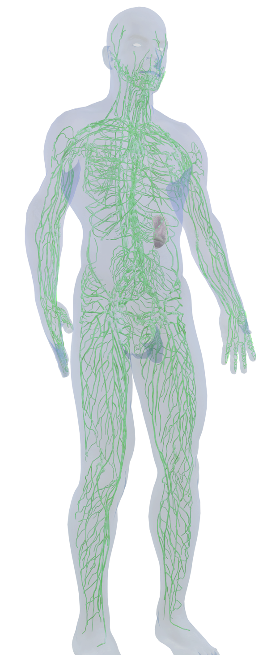



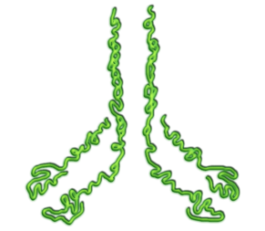
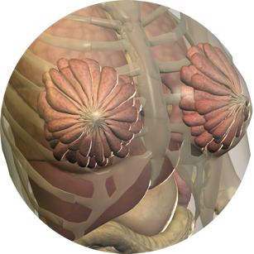
Lymphatic System
The reproductive system interacts with the lymphatic and immune systems:
  Immune cells protect against pathogens. Regulatory T cells important to the immune system tolerance of the developing fetus.
  Lymphatic (and blood) vessels transport sex hormones.
  Maternal antibodies pass into the fetus in-utero and are present in breast milk, providing passive immunity.
  Increased abdominal pressure in pregnancy impairs lymphatic return, leading to edema.
Testosterone

Slide 14
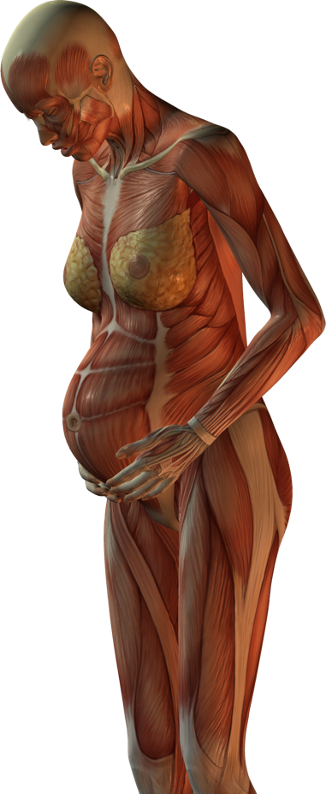

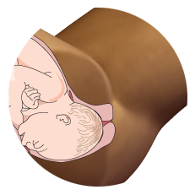
Muscular System
The reproductive system interacts with the muscular system:
  Androgens promote an increase in muscle mass in post-pubertal males.
  Pelvic floor muscles provide support for the reproductive organs and are involved in aspects of the sexual response.
  Abdominal, uterine, and pelvic floor muscles are active in childbirth.
Testosterone

Slide 15
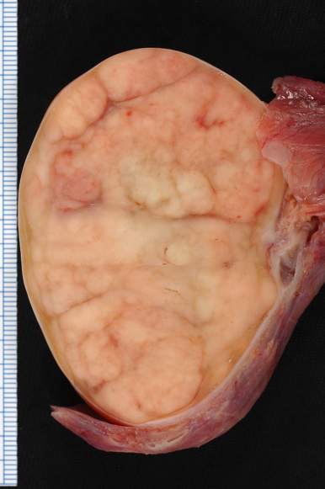
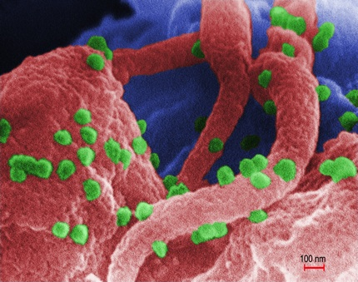
Disease
The reproductive system is susceptible to numerous diseases.
  Male and female reproductive systems suffer different diseases e.g. testicular cancer in males, ovarian cancer in females.
Sexually transmitted infections (STIs) affecting the reproductive system are transmitted during sexual activity.
Both males and females can suffer disorders that cause infertility, although they are of different origins.
Disorders or diseases during pregnancy may affect the fetus or the birth process.
Disorders in the offspring may occur because of genetic defects inherited from the parents.
Testicular cancer
Photo: Ed Uthman
HIV budding from cells
Image: CDC

Slide 16
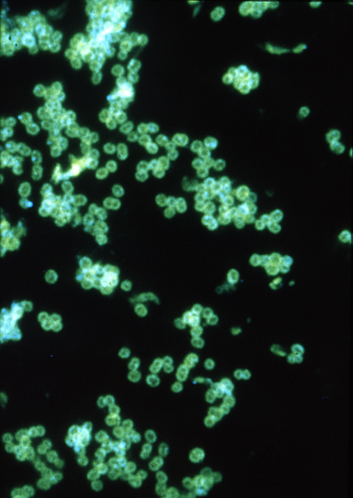
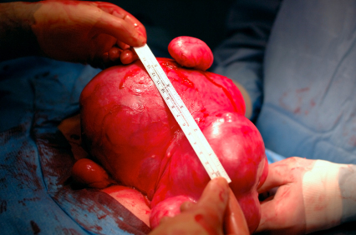
Symptoms of Disease
Symptoms of disease or infection of the reproductive system include:
  Pain (moderate to severe)
    Pain during urination or sexual intercourse can be an indicator of an infection of the reproductive system.
  Abnormal bleeding
    Bleeds during pregnancy may indicate potential problems that may lead to miscarriage.
  Infertility.
    Many diseases can cause infertility. Congenital disorders may also cause infertility.
Fluorescent antibody stain of Neisseria gonorrhoeae a sexually transmitted infection.
CDC
Ovarian tumor
Istock

Slide 17
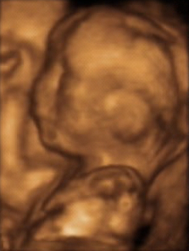
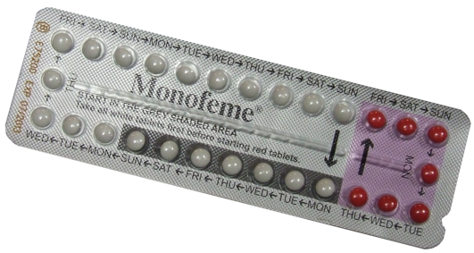
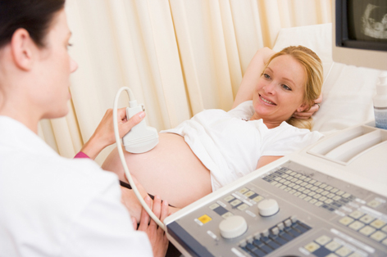
Medicine and Technology
Medical technology has been influential in reproductive health and physiology.
  The development of oral contraceptives has changed how people approached sexual relationships.
  Faster, more powerful computers now allow imaging of the fetus in 3D and 4D.
  Reproductive technologies have enabled thousands of people to conceive when they have not been able to naturally.
3-D ultrasound image of fetus
Staecker
Oral contraception
K.Pryor
Pregnancy ultrasound
istock

Slide 18
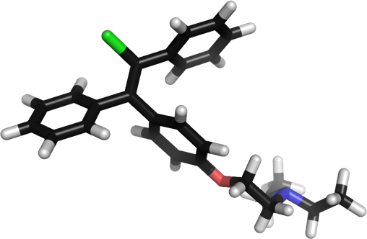
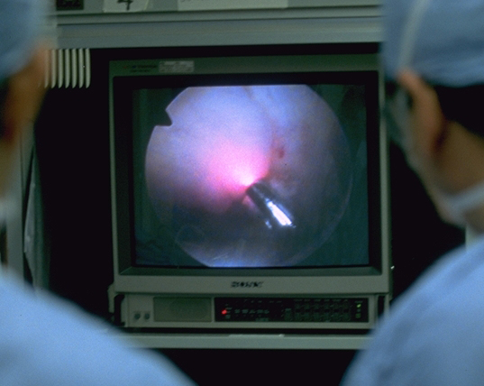
Treatment of Infertility
Clomifene is used as a fertility treatment in women.
Infertility treatments can apply to both males and females:
  Assisted reproductive technologies
    In-vitro fertilization and intra-cytoplasmic sperm injection are common techniques used to increase fertilization when the cause of infertility can be diagnosed or treated.
  Hormone therapy
    Synthetic hormones such as clomifene are used to induce follicle development and ovulation.
  Laparoscopic surgery
    Laparoscopy (photo, right) may be used to determine if there are any defects to the ovaries or uterus which may be reducing fertility. It is becoming less common due to advances in other IVF treatments.
Gazelle Technologies: Medical Library

Slide 19
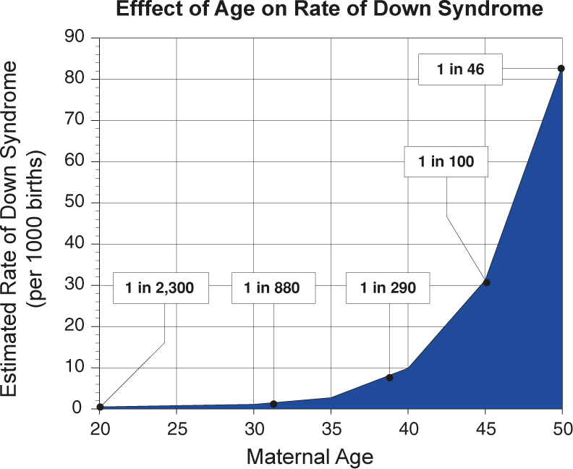
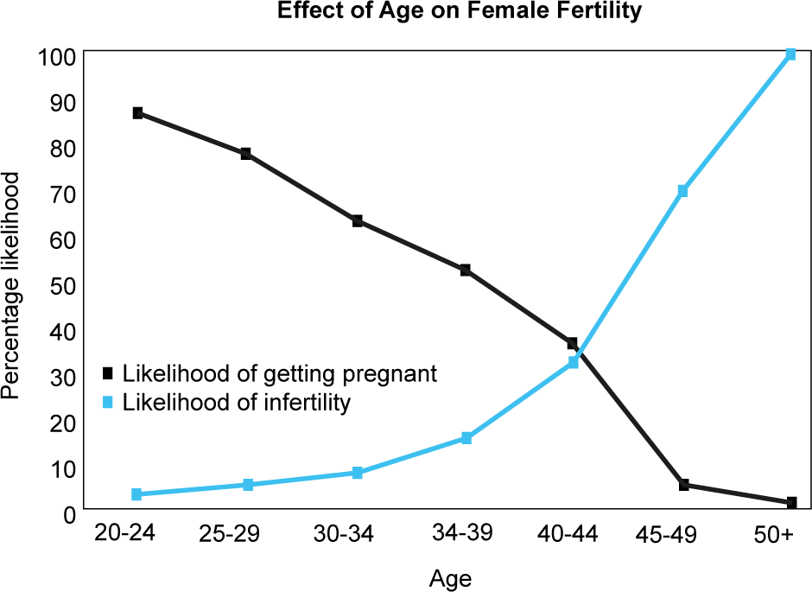
Effects of Age
There are numerous changes in the reproductive system throughout the human life span.
The onset of puberty is also the onset of reproductive maturity, and while men are reproductively viable to until the end of their life, women have a limited reproductive life-time.

Slide 20

Age and the
Reproductive System
As age increases, the reproductive system loses some of its functional abilities.
  Decline in sperm production and erectile function
    Testicular mass decreases with age. Many reproductive problems in men are not directly linked to aging, but a result of other age related conditions, such as high blood pressure.
  Cessation of menses
    Menopause in women is most commonly experienced at around age 50. Ovaries stop releasing eggs and the menstrual cycle stops.
  Thinning and prolapse of organs.
    Testicular mass decreases in males. In females, vaginal walls become thinner, less elastic, and less rigid.
CA

Slide 21

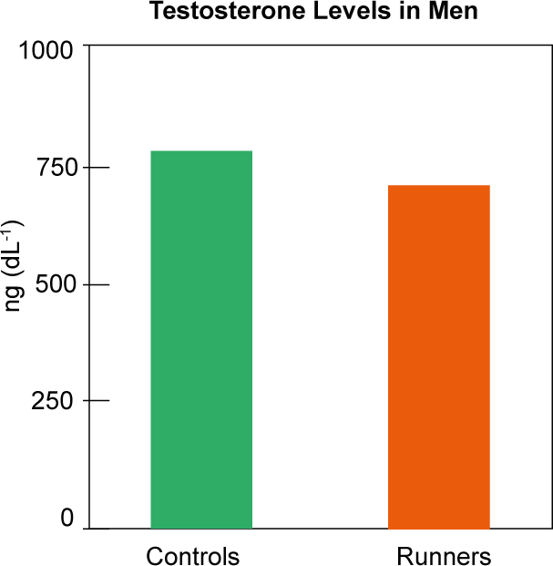
Exercise
Exercise can have a number of effects on the reproductive system.
  Regular exercise can improve muscle tone of the pelvic floor muscles.
  In men, cardiovascular fitness can improve sperm production leading to higher sperm counts.
  Exercising too hard or to exhaustion too frequently can reduce fertility in women.
Regular exercise depresses the reproductive hormones in both men and women. In male endurance athletes, the resting testosterone levels are about 60-80% of those of sedentary men. However the implications of this difference are not clear.
TG

Slide 22
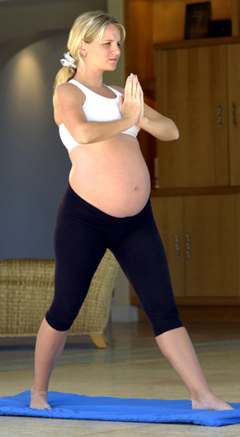
Effects of Exercise
Exercise can have both beneficial and negative effects on the reproductive system
  Improved muscle tone
    Good muscle tone (especially the pelvic floor muscles) is important for childbirth and urinary continence.
  Heavy endurance exercise can lead to hormonal irregularities
    The effects of hormonal irregularities are especially significant in women, leading to irregular menstrual cycles and infertility.
  Exercise can be beneficial during pregnancy
    Exercise during pregnancy can help alleviate problems such as swelling in tissues by improving circulation. It can also help prepare the mother for childbirth by increasing muscle tone, and prolonging time to exhaustion.
CA

Slide 23
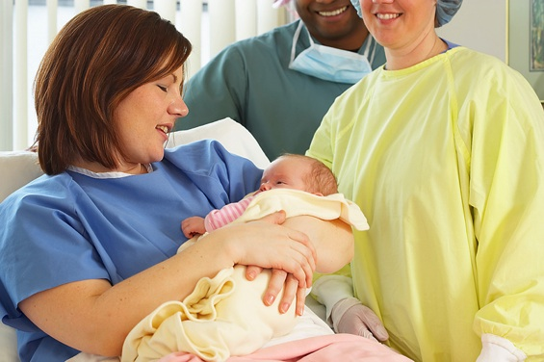
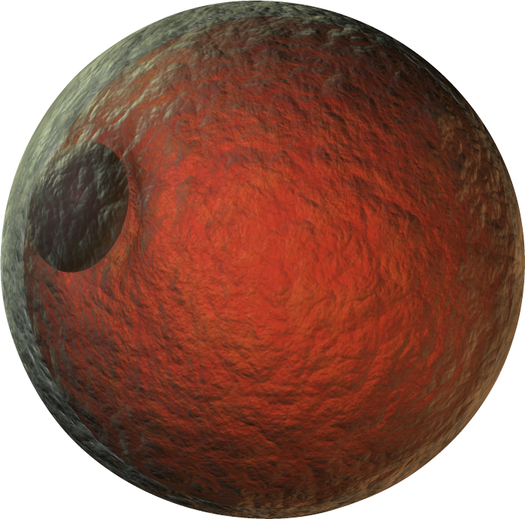
Female Reproductive System
The female reproductive system:
  produces eggs
  receives the penis and sperm during sexual intercourse
  houses and nourishes the developing young
Humans are placental mammals. The placenta is a temporary endocrine organ that supports the fetus during gestation.
CA
Egg cell (ovum)

Slide 24
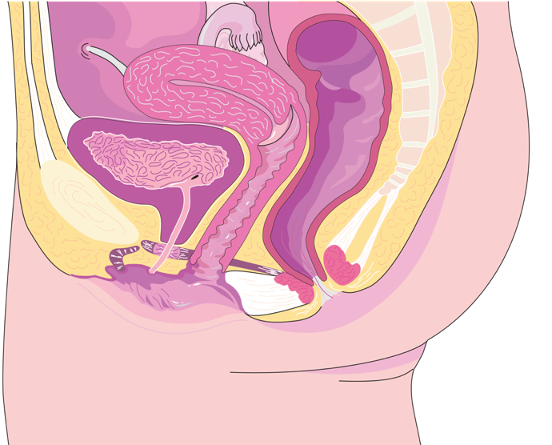
Female Reproductive System
Uterus
Fallopian tube
Ovary
Colon
Bladder
Spine
Urethra
Cervix
Pubis (pubic bone)
Anus
Clitoris
Labia
Vagina
LA
Sagittal section through female abdomen

Slide 25
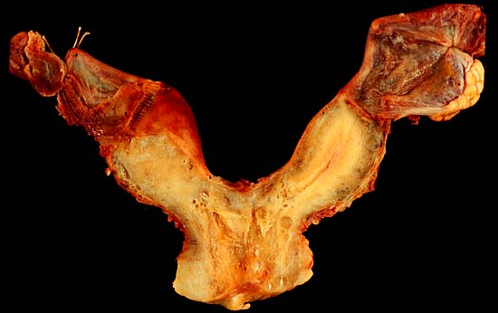
Disorders of the Female Reproductive System
Disorders of the female reproductive system include:
  Sexually transmitted infections STIs include viral, bacterial, fungal and protozoan infections as well as parasites such as lice.
  Cancers, e.g. cervical cancer.
    Cancers can cause in fertility and are fatal if untreated.
  Congenital abnormalities
    Some abnormalities can be serious or fatal, while others, such as a bicornate uterus (uterus has a heart shape), as less so.
  Functional disorders
    These include infertility, ectopic pregnancy, and endometriosis.
Photo: Ed Uthman
Bicornate uterus

Slide 26
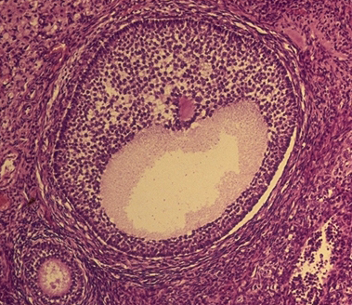
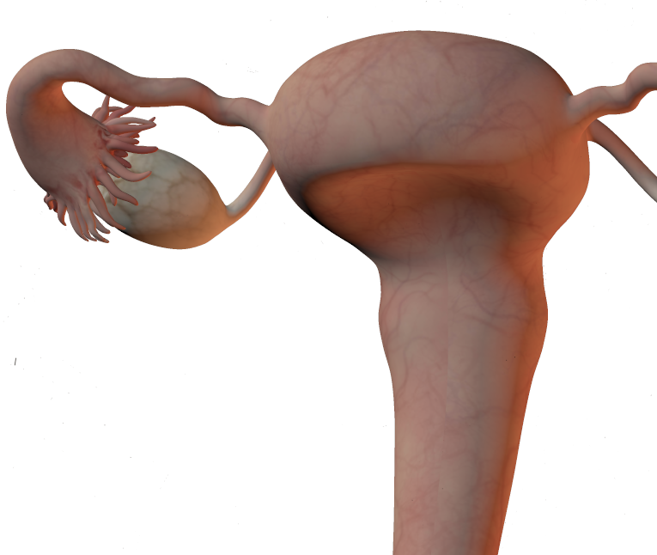
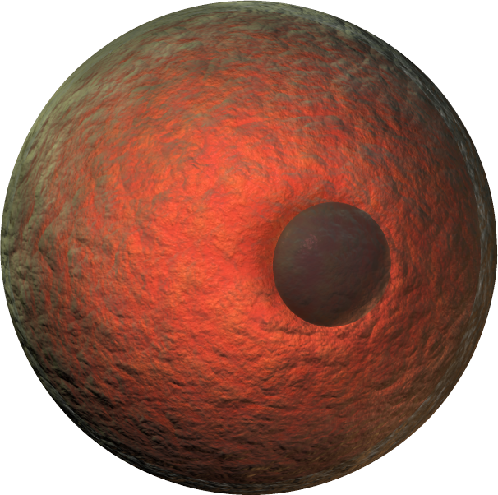
Oogenesis
Oogenesis is the process by which mature ova (egg cells) are produced by the ovary.
Oogonia are formed in the female embryo and undergo mitotic divisions to form the primary oocyte.
All the eggs a female will ever be able to produce are present at birth. Only a fraction of those present will be released (ovulated) for fertilization.
Secondary (Graafian) follicle
EII
Uterus
Ovary
In her reproductive lifetime, a female will produce around 430 eggs.
Ovum
Polar body

Slide 27
Oogenesis
Oogonium
Growth (mitotic cell division)
Once the primary oocyte forms in the fetus (prophase of meiosis I), it remains resting until puberty. At puberty meiosis resumes.
Primary oocyte (2N)
Completed in the fetus
1st meiotic division (meiosis I)
Secondary oocyte (N)
Completed in adult before fertilization
Eggs released during ovulation are arrested in metaphase of meiosis II.
2nd meiotic division (meiosis II)
Completed in adult after fertilization
This second division is completed only after fertilization.
Mature ovum (N)
Second polar body (N)
Additional polar bodies (do not always form)

Slide 28
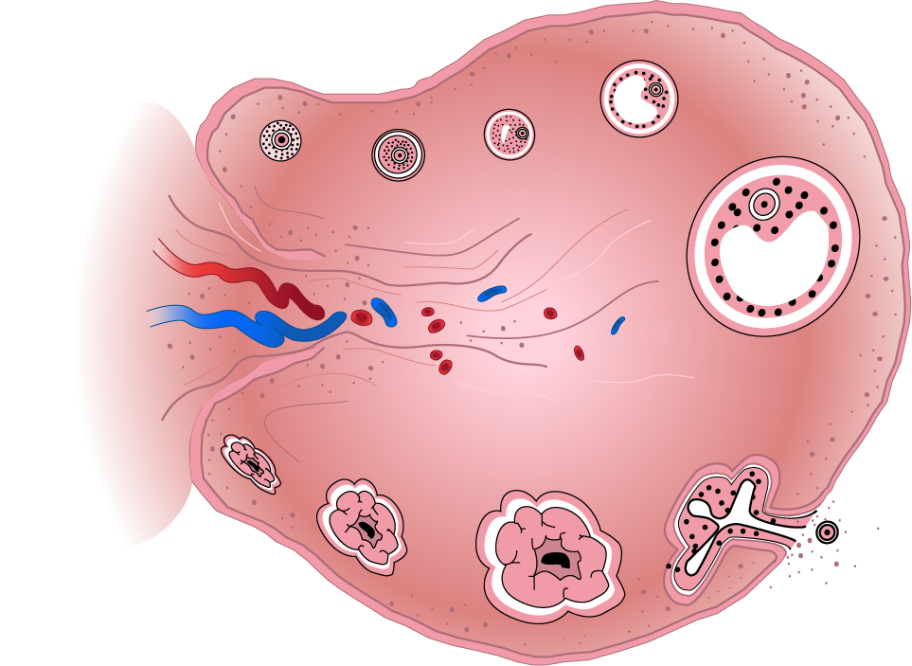
Development of the Egg
Primordial follicle
Primary follicle
Secondary follicle
Germinal epithelium
Primary oocyte (2N)
Secondary oocyte (N)
Follicular fluid
Mature follicle (Graafian follicle)
Blood vessels
Ovary
Sequence of development
Corpus hemorrhagicum (ruptured follicle)
Corpus albicans
Secondary oocyte
Mature corpus luteum
Blood clot
Early corpus luteum

Slide 29





Ovulation and Implantation
Eggs (or ova) are produced by the ovaries and are released at ovulation.
The unfertilized egg lives for only a day or so. It travels along the fallopian tube, where fertilization may occur if sperm are present.
Frontal section of uterus and reproductive structures.
Eggs are produced in the ovaries
If the egg is fertilized, it will become implanted in the lining of the uterus. If it is not fertilized, the prepared endometrial lining is shed, passing out through the vagina in menstruation.
Fertilization occurs in the fallopian tube, after which the zygote passes to the uterus.
LA

Slide 30

The Menstrual Cycle
Females are sexually receptive throughout the year and may mate at any time. The periodicity of the reproductive cycle is about 28 days.
The uterine lining thickens in preparation for pregnancy.
If fertilization of an ovum does not take place, this lining is shed as a discharge through the vagina.
This event, called menstruation, characterizes the human reproductive or menstrual cycle.
Days 26-28
Full degradation of uterine lining leading to menstruation
Days 1-7
Menstruation
Days 18 - 25
Corpus luteum regresses and uterine lining begins to break down
Days 8 - 11
Thickening of the uterine lining
Days 12-15
Ovulation

Slide 31

LH and FSH
Luteinizing hormone (LH) and follicle stimulating hormone (FSH) are produced by the anterior pituitary gland and regulate the menstrual cycle.
FSH stimulates the development ovarian follicles, resulting in the release of estrogen.
Estrogen levels peak, stimulating a surge in LH and triggering ovulation.
FSH stimulates follicle development
LH surge in response to peak in estrogen triggers ovulation
FSH
LH
Day of cycle
Follicular phase
Menstruation, follicle development
Ovulatory phase
Ovulation
Luteal phase
Formation of corpus luteum
Fluctuations in pituitary LH and FSH

Slide 32

Estrogen and Progesterone
Many ovarian follicles begin developing in response to FSH, but it is usually only the Graafian follicle, that becomes dominant.
In the first half of the cycle, estrogen is secreted by the developing Graafian follicle.
Later, the Graafian follicle develops into the corpus luteum ( yellow body) which secretes of progesterone (and smaller amounts of estrogen).
Progesterone maintains the thickened uterine lining in preparation for the implantation of a fertilized egg.
Estrogen promotes repair and growth of the uterine lining
Day of cycle
Follicular phase
Menstruation, follicle development
Ovulatory phase
Ovulation
Luteal phase
Formation of corpus luteum

Slide 33

The Ovarian Cycle
The Graafian follicle continues to grow and then (around day 14) ruptures to release the egg (ovulation).
LH causes the ruptured follicle to develop into the corpus luteum (yellow body).
The corpus luteum secretes progesterone which:
  promotes full development of the uterine lining
  maintains the embryo in the first 12 weeks of pregnancy
  inhibits the development of more follicles.
Ovulation; the follicle ruptures to release the egg. The egg may be fertilized.
Corpus luteum degenerates, progesterone secretion stops, and the uterine lining breaks down
Follicle surrounding the egg grows in response to FSH
Day of cycle
Follicular phase
Menstruation, follicle development
Ovulatory phase
Ovulation
Luteal phase
Formation of corpus luteum

Slide 34

The Menstrual Cycle
If fertilization does not occur, the corpus luteum breaks down.
  As a consequence of this, progesterone secretion declines, causing the uterine lining to be shed, (menstruation).
If the egg is fertilized, high progesterone levels maintain the thickened uterine lining.
  The placenta takes over from the corpus luteum completely by twelve weeks, nourishing the fetus for the remainder of the gestation.
The uterine lining breaks down because fertilization did not occur
Menstruation
Growth of uterine lining
Lining vascular and glandular
Day of cycle
Follicular phase
Menstruation, follicle development
Ovulatory phase
Ovulation
Luteal phase
Formation of corpus luteum

Slide 35


Control of the Menstrual Cycle
The hypothalamus and the anterior pituitary gland are the main control centers for the regulation of the menstrual cycle.
The hypothalamus secretes GnRH, which is transported in the blood to the anterior pituitary where is brings about the release of two hormones: FSH and LH.
  FSH causes development of the ovarian follicle.
  LH stimulates ovulation and the development of the corpus luteum.
Regulation of hormone levels is achieved by negative feedback mechanisms.
Gonadotropin releasing hormone (GnRH)
Follicle stimulating hormone (FSH)

Slide 36


Follicular Phase
GnRH
In the first half of the menstrual cycle, FSH stimulates follicle development in the ovary.
The developing follicle secretes estrogen, which acts on the uterus and (via the hypothalamus) inhibits FSH secretion from the anterior pituitary.
Estrogen
FSH
Estrogen
Pointer indicates developing follicle
Image: Jpogi

Slide 37

Ovulation and Luteal Phase
GnRH
In the second half of the menstrual cycle, LH induces ovulation and development of the corpus luteum.
The corpus luteum secretes progesterone, which acts on the uterus.
  Progesterone also inhibits further secretion of LH (and also FSH) from the anterior pituitary (via the hypothalamus).
Progesterone
LH
Image: university of Delaware
Progesterone
Corpus luteum

Slide 38



Feedback Mechanisms
FSH/LH secretion occurs in response to a hormone signal from the hypothalamus
Hypothalamus
GnRH
–
–
Estrogen inhibits FSH secretion (negative feedback)
Anterior pituitary gland
Progesterone inhibits LH and FSH secretion (negative feedback)
+
+
Developing Graafian Follicle secretes estrogen
Estrogen
Progesterone
Ovulation/development of corpus luteum which secretes progesterone
Repair and growth of the uterine lining
Thickening and maintenance of the uterine lining

Slide 39

Male reproductive system
Sperm duct (vas deferens)
Bladder
Seminal vesicle
Urethra
Prostate gland
Glans penis
Epididymis
LA
Scrotal sac
Testis

Slide 40


The Testes
The testes produce the male hormone testosterone and are the site of sperm development.
Sperm develop in the seminiferous tubules and mature in the epididymis.
Structure of testis
Vas deferens:
Carries sperm to the urethra
The epididymis is a coiled tube where the sperm develop motility
Seminiferous tubules are bundles of coiled tubes leading to the epididymis.
Section through testis showing seminiferous tubules. Each tubule is 50-60 cm long. In total there is about 600 m of tubules.
EII

Slide 41


Spermatogenesis 1
Spermatogenesis is the process by which spermatozoa (sperm) are produced in the testis.
In humans sperm are produced at a rate of about 120 million per day and live only 2-3 days. If they are not ejaculated in this time they are broken down and reabsorbed.
Spermatogenesis is regulated by the hormones FSH and testosterone
Section through seminiferous tubules
Sperm
Spermatid
Sertoli cell
Spermatid
Early spermatid
Primary spermatocyte
Secondary spermatocyte
Sertoli cell
Primary spermatocyte
Direction of Development of sperm
Spermatogonium
Spermatogonia
Blood vessel
EII

Slide 42



Spermatogenesis 2
Spermatogonia (in the outer layer of the seminiferous tubules) multiply throughout reproductive life.
Some of them divide by meiosis into spermatocytes, which produce spermatids.
These are transformed into mature sperm by the process of spermiogenesis in the seminiferous tubules of the testis.
Full sperm motility is achieved in the epididymis.
Spermatogonium
Growth (mitotic cell division)
Primary spermatocyte (2N)
1st meiotic division (meiosis I)
Secondary spermatocyte (N)
2nd meiotic division (meiosis II)
Spermatids (N)
Sperm

Slide 43

Sperm structure
Sperm are relatively simple in structure, as their sole purpose is to swim to the egg and deliver their genetic material.
They are composed of three main regions: the head, the mid-piece and the tail.
Acrosome: enzyme-filled bag at the tip of the sperm.
5 µm
Nucleus
Mitochondrion
Head: Contains the nucleus and acrosome.
Midpiece: Has many mitochondria to generate the energy for swimming.
Tail: A long flagellum that propels the sperm in its swim to the egg.

Slide 44


Disorders of the Male Reproductive System
Male reproductive disorders include:
  Sexually transmitted infections:
  STIs include viral, bacterial, fungal and protozoan infections as well as parasites such as lice.
  Cancers e.g. prostrate cancer:
  Cancers can cause infertility and can be fatal.
  Congenital abnormalities:
  These include androgen insensitivity
  syndrome. People who are genetically male (XY) develop female sexual characteristics due to the body’s inability to use androgens.
  Functional disorders:
  These include erectile dysfunction and premature ejaculation.
Istock
Prostate cancer
PD-USGov-HHS-CDC
HIV virions (green) budding from a cultured lymphocyte. HIV is an infection that can be transmitted by sexual activity.

Slide 45


Diagnosing Reproductive Disorders
Techniques to diagnose disorders include:
  MRI and ultrasound
    MRI and ultrasound can be used to
    identify diseases such as breast cancer.
  Semen analysis
    Semen analysis may be used to investigate
    causes of infertility or to verify the success
    of a vasectomy.
  Laparoscopy
    Laparoscopy can be used to diagnose the
    source of female infertility or to view outside the reproductive tract.
  Blood and DNA tests
    Blood tests are commonly use to detect STIs, while DNA tests can be used to diagnose fetal disorders early in the pregnancy.
Istock
Ultrasound examination of breast
Istock
Blood test

Slide 46

Treating Reproductive Disorders
Reproductive disorders can be treated using a range of methods.
  Drug therapy
    Bacterial STIs can be treated using antibiotics while some causes of infertility can be treated with drugs that stimulate ovulation.
  Hormone therapy
    Hormone therapy may be used to treat age-related reproductive disorders, gender reassignment, or genetic disorders.
  Surgery
    Surgery (right) can be used to treat reproductive cancers, or to prevent cancer in people who are at high risk of developing it.
    Surgery (such as a Caesarian section) is also used when there are complications during childbirth.
PC

Slide 47


Fertilization
Fertilization occurs when a single sperm penetrates an egg cell.
The sperm and egg unite to form a zygote.
Fertilization is always regarded as time 0 in a period of gestation and has five distinct stages (capacitation, acrosome reaction, fusion of sperm, cortical reaction, fusion of nuclei).
After fertilization the zygote begins its development into a multicellular organism.
Istock

Slide 48


Capacitation
The surface of the sperm undergoes functional changes while in the female reproductive tract that allow it to fertilize the egg cell.
The plasma membrane becomes more fluid to enable greater binding with the egg cell.
The acrosome becomes fragile.
Zona pellucida

Slide 49

The Acrosome Reaction
Enzymes (hyaluronidase, acrosin, and neuraminidase) from the acrosome are released and digest a pathway through the follicle cells (not shown) and the jelly like zona pellucida surrounding the secondary oocyte (egg cell).
The combined efforts of many sperm are required for just one to enter the egg cell.

Slide 50
Fusion of Membranes
The plasma membranes of the sperm and egg fuse, and the nucleus of the sperm enters the egg cytoplasm.
Fusion causes a sudden membrane depolarization that acts as a fast block to further sperm entry.
The fusion of the two plasma membranes also triggers the completion of meiosis II in the egg cell and induces the next stage of the fertilization sequence.

Slide 51

The Cortical Reaction
The fusion of the two plasma membranes induces a permanent change in the egg surface that prevents further sperm entry.
Cortical granules in the egg cytoplasm release their contents into the space between the plasma membrane and the vitelline layer.
Substances released from the granules raise and harden the vitelline layer to form a slow (permanent) block to further sperm entry.
Sperm nucleus (N= 23)
Egg nucleus (N=23)
The fusion of the sperm nucleus with the egg nucleus to form the zygote completes fertilization.
Cortical granules

Slide 52


Cleavage and Morula
Rapid cell division takes place Immediately after fertilization.
These early cell divisions are called cleavage and they increase the number of cells, but not the size of the zygote.
The first cleavage is completed after 36 hours, and each succeeding division takes less time.
After three days, successive cleavages have produced a solid mass of cells called a morula, which is still about the same size as the original zygote.
LA
LA
Zygote (first division)
Morula (4-5 divisions)

Slide 53

Implantation
After several days in the uterus, the morula develops into the blastocyst.
It makes contact with the uterine lining and pushes deeply into it, ensuring a close maternal-fetal contact.
Blood vessels provide early nourishment as they are opened up by enzymes secreted by the blastocyst.
The embryo produces HCG (human chorionic gonadotropin), which prevents degeneration of the corpus luteum and signals that the woman is pregnant.
The blastocyst, a hollow ball of cells, embeds into the uterine wall using enzymes to digest and penetrate the lining.
The uterine lining provides nourishment for the embryo until the placenta develops.
LA

Slide 54

Embryo
The placenta forms from the fetal membranes and the maternal uterine lining
Five weeks after fertilization, the embryo is only 4-5 mm long, but already the central nervous system has developed and the heart is beating.
The embryonic membranes have formed. The amnion encloses the embryo in a fluid-filled space, and the fetal membranes (allanto-chorion) form the fetal portion of the placenta.
From two months the embryo is called a fetus.
The yolk sac is small in humans.
Umbilical cord
The fluid-filled amniotic sac encloses the embryo in the amniotic fluid.
LA
5 week old embryo

Slide 55

Fetus
Placenta
The early fetus is still small (30-40 mm long), but the limbs are well formed and the bones are beginning to harden.
  The face has a flat, rather featureless appearance with the eyes far apart.
  Fetal movements have begun and brain development proceeds rapidly.
The placenta is well developed, although not fully functional until 12 weeks.
  The umbilical cord, containing the fetal umbilical arteries and vein, connects the fetus and mother.
LA
Amniotic fluid
Umbilical cord
12 week old fetus

Slide 56

First Trimester
Pregnancy lasts for about 40 weeks. The time is divided into 3 trimesters, each lasting 3 months (about 13 weeks).
Changes to the female body during the first trimester include:
  Breasts become larger and tender.
  Areola (area around nipple) may darken.
  Frequency of urination will increase.
  Nausea and vomiting are common, although some people experience far more acutely than others.
  Abdomen may begin to swell towards end of the trimester.

Slide 57

Second Trimester
Changes to the female body during the first trimester include:
  Weight gain.
  Abdomen obviously swollen.
  Heart rate increases.
  Breasts continue to enlarge.
  Uterus will begin to compress the intestines and fill the abdominal cavity.

Slide 58

Third Trimester
Changes to the female body during the first trimester include:
  Weight gain (most weight gained during pregnancy is during the final trimester).
  Stretch marks may appear on the skin.
  Fatigue, back pain and heart-burn become common in many women.
  During the later stages of pregnancy, the abdomen drops as the fetus moves into position for birth.
  Including gain of fat tissue, fluid, breast tissue, the placenta, and the fetus, the female may have to carry an extra 15 kilograms by the end of the third trimester.

Slide 59

The Placenta
Placenta
As soon as an embryo embeds in the uterine wall, it begins to obtain nourishment from its mother.
The placenta is the specialized organ that enables the exchange of nutrients from the mother to the fetus and wastes from the fetus to the mother.
The placenta also has an endocrine role, producing hormones that enable the pregnancy to be maintained.
Fetus
Umbilical cord

Slide 60

The Placenta
The placenta is a disc-like organ, about the size of a dinner plate and weighing about 1 kg.
It develops when finger-like projections of the fetal chorion (the chorionic villi) grow into the endometrium of the uterus.
  The villi contain the numerous capillaries connecting the fetal arteries and veins.
The villi invade the maternal tissue until they are bathed in the maternal blood sinuses.
  The close proximity of the fetal and maternal blood vessels allows for the exchange of oxygen, nutrients, and wastes between the maternal and fetal blood.
Wikimedia

Slide 61

Schematic of the Placenta
Sinus filled with maternal blood
Chorionic villus with fetal arterioles and venules
Blood flow
Chorionic tissue (fetal)
Exchange of wastes and nutrients via diffusion
Umbilical vein
Umbilical cord
Umbilical artery
Boundary between fetal and maternal tissues
Maternal endometrium
Maternal venules
Maternal arteriole

Slide 62


Interrupting the Cycle
The menstrual cycle follows a set pattern that is regulated by the interplay of several hormones.
  Hormone release is regulated through feedback mechanisms. The levels of estrogen and progesterone regulate the secretion of pituitary hormones that control the ovarian cycle.
Pregnancy interrupts this cycle and maintains the corpus luteum and the placenta as endocrine organs with the specific role of maintaining the developing fetus.
During the last month of pregnancy, the peptide hormone oxytocin induces the uterine contractions that will expel the baby from the uterus.
Estrogen
Progesterone

Slide 63


Hormones and Pregnancy
Corpus luteum maintains pregnancy for the first three months by secreting progesterone
Human chorionic gonadotropin (HCG) from the implanted embryo maintains the corpus luteum
HCG
Hormones from the placenta maintain the pregnancy from three months onwards and prepare the breasts for lactation. Through pregnancy the placenta also secretes increasing quantities of HCS (human chorionic somatotropin) which benefits fetal growth.
Estrogens and progesterone maintain the pregnancy
LA

Slide 64

Progesterone Changes
During the first 12 weeks of pregnancy, the corpus luteum secretes enough progesterone to maintain the uterine lining and sustain the developing embryo
After this, the placenta takes over as the primary endocrine organ of pregnancy.
High progesterone maintains the pregnancy and also inhibits secretion of prolactin.
Progesterone (from placenta)
Progesterone (from corpus luteum)
Progesterone levels fall at the end of pregnancy as the placenta loses competence.
First trimester
0
10
20
30
40
50
Time (Weeks)

Slide 65

Estrogen Changes
Progesterone maintains the lining of the uterus early in pregnancy and the placenta once it develops.
  Its also prepares the mammary glands for lactation and inhibits labor.
Estrogen levels increase to maintain the uterine lining and prepare the mammary glands for lactation.
Estrogen maintains uterine lining
Estrogen peak sensitizes the uterus and induces labor
Second trimester
0
10
20
30
40
50
Time (Weeks)

Slide 66

Labor and Oxytocin
At the end of pregnancy, the placenta loses competency (works less efficiently) as a result of falling progesterone levels. High estrogen levels then trigger the onset of labor.
A estrogen peak coincides with an increase in oxytocin, which stimulates uterine contractions.
  Labor progresses as a result of positive feedback. The increasing pressure on the cervix stimulates the release of more oxytocin, which increases the force of the contractions.
After birth, the secretion of prolactin increases.
  Prolactin maintains lactation during the period of infant nursing.
  Prolactin secretion is inhibited by high progesterone during pregnancy.
Prolactin starts and maintains milk secretion
Third trimester
Oxytocin stimulates contraction of the uterus during labor
0
10
20
30
40
50
Time (Weeks)

Slide 67

Detecting Pregnancy
Pregnancy testing is used to determine whether or not a woman is pregnant.
The most frequently used methods involve chemical markers in urine or blood.
Ultrasonography is usually used to confirm the continuing pregnancy and development of the fetus at twelve weeks, although it is sometimes used earlier and later.

Slide 68


Pregnancy Testing
Human chorionic gonadotropin (HCG) is released from the implanted embryo of a pregnant woman.
  HCG accumulates in the bloodstream and is excreted in the urine.
  HCG is a glycoprotein. Antibodies against it can be used in
  simple test kits (below) to determine if a woman is pregnant.
  A colored band above the dipstick indicates a positive test.
Colored band appears in the result window only if HCG is present.
Dipstick held in the urine.
Colored band appears in control window to show the test has run correctly.
Istock

Slide 69


How Pregnancy Tests Work
Home pregnancy detection kits utilize monoclonal antibody technology.
The test area of the dipstick (below) contains two types of antibodies: free monoclonal antibodies and capture monoclonal antibodies, bound to the substrate in the test window (arrowed).
Dipstick
Immobilized capture antibodies
Antibody moves by capillary action
Antibodies tagged with blue latex
HCG bound to free antibody
Colored latex in test window
HCG in the urine of a pregnant women binds to the color-labeled antibodies. The antibodies then travel up the dipstick by capillary action.
The HCG-antibody complexes are bound by capture antibodies. The labeled antibodies create a colored line in the test window.

Slide 70

Contraception
Contraception refers the the methods or devices that prevent conception.
Contraceptive methods include both physical and chemical methods, and range from methods preventing fertilization to methods that inhibit development of the embryo.
The most effective methods for contraception involve chemical interference of the female cycle so that egg production is inhibited.
  Methods such as the oral contraceptive pill are around 99.9% -100% effective if used correctly.
COR

Slide 71


Contraceptive Methods
Methods of contraception have been used to hundreds of years, although modern forms, such as the contraceptive pill, have only become common since the 1960s.
  Barrier (physical)
    Barriers prevent the sperm reaching the egg. They include condoms and diaphragms.
  Homonal
    The oral contraceptive pill (OCP) is the most common hormonal contraception in use.
  Surgical sterilization
    Vasectomy involves cutting the vas-deferens to prevent sperm entering the semen. It is a common procedure with few complications.
    Tubal ligation involves clamping or severing the fallopian tubes, preventing eggs reaching the uterus.
Intra-uterine devices (IUDs) interfere with sperm motility and prevent implantation. Some also release hormones.
Gleocknerd
Axefan2
A diaphragm forms a physical barrier over the cervix to sperm entry. Coin indicates size.

Slide 72


Contraception
The placement of contraceptives in the reproductive cycle is illustrated below:
Female |  | Male
Method | Event | Event | Method
Production of viable eggs
Production of viable sperm
Combined oral contraceptive pill
Vasectomy (cutting the vas deferens)
Ovulation (release of eggs)
Sperm transport in tubules
Progesterone- only pill (mini pill)
Abstinence
Condom
Coitus interruptus (high failure rate)
Abstinence from sexual intercourse
Capture of egg by fallopian tube
Sperm deposited in vagina
Tubal ligation

Slide 73



Contraception
Female |  | Male
Method | Event | Event | Method
A Male Pill?
Research into this area is continuing but proposals for a male contraceptive pill are based on either hormonal (as is the female contraceptive pill) or non-hormonal treatment.
Hormonal based treatment involves using doses of testosterone and progesterone.
Non-hormonal treatments may involve using chemical inhibitors to block production of key structural proteins in sperm cells.
Spermicides,
diaphragm,
contraceptive sponge,
vaginal condom
Transport of egg in fallopian tube
Sperm movement towards egg
Union of sperm and egg
Intrauterine device (IUD)
Implantation of blastocyst
Termination
RU-486 (abortion pill)
Maintenance of pregnancy

Slide 74

The Oral Contraceptive Pill
The combined oral contraceptive pill (OCP) exploits the feedback controls over hormone secretion that normally operate in the menstrual cycle.
They contain combinations of synthetic estrogens and progesterone.
  A single pill is taken daily for 21 days. This raises the levels of these hormones in the blood, inhibiting FSH secretion and development of the ova.
  A sugar pill is then taken daily for 7 days. This is long enough for menstruation to occur, but not for the ova to develop.
CA

Slide 75


Cause of Infertility
Infertility is a common problem, and as many as one in six couples require help from a specialist.
Causes may be inherited, or due to damage or infection. They may even be psychological.
Causes of male infertility include:
Penis: failure to achieve or maintain
an erection, abnormal ejaculation
Testes: Too few sperm produced or
sperm are abnormally shaped or
have impaired motility or life span
Vas deferens: Blockage that
impedes sperm passage.
Causes of female infertility include:
Fallopian tubes: Blockage that
may prevent sperm from reaching
the eggs.
Ovaries: Eggs may fail to mature or
be released.
Cervix: Antibodies in cervical mucus
may damage or destroy sperm.
Istock
CA

Slide 76

Treating Female infertility
Failure to ovulate is a common cause of female infertility.
  In most cases the cause is hormonal, although sometimes the ovaries may be damaged or not functioning correctly.
  Damage to the fallopian tubes may also cause infertility.
Infertility may be treated with hormones and/or IVF.
  Hormones are used to stimulate ovulation, boost egg production, and induce egg release.
Polycystic Ovary Syndrome (PCOS) affects around 10% of all women and is one of the most common causes of infertility.
Image: Ekem
Damage to the ovaries, which may be caused by disease, such as this ovarian tumor, may lead to an inability to ovulate.

Slide 77





Treating Female Infertility
Cause of the infertility
Failure to ovulate because of low levels of GnRH, FSH, LH or ovarian hormones.
Pituitary
Hormone imbalance can be corrected using estrogen-like drugs e.g. clomifene and tamoxifen, which induce release of FSH from the pituitary.
Hormonal treatment successful?
Treatment may enable conception in the usual way.
Sometimes fertility drugs containing FSH and/or LH are used. These induce the release of many ova, increasing the chance of a multiple pregnancy.
FSH & LH
Egg production and ovulation
Fallopian tubes blocked?
Eggs may be collected from the follicles using laparoscopy and fertilized ex-vivo in a glass dish (in-vitro fertilization (IVF)
CA
Human chorionic gonadotrophin (HCG) can replace LH and may be injected to induce ovulation.
At an early stage of cell division, the pre-embryo is transferred to the uterus. A pregnancy results if implantation is successful.
Ovary

Slide 78
Reproductive Technology
Assisted Reproductive Technologies (ARTs) may enable couples that are unable to conceive naturally to increase their chances of conceiving.
Techniques include:
  In vitro fertilization (IVF)
  Gamete intra-fallopian transfer (GIFT)
% of ART performed in U.S. fertility clinics in 2009
Outcomes of ART performed in U.S. fertility clinics in 2009
Type of ART | % of total ART techniques
IVF | >99%
GIFT | <1%
Age | <35 | 35-37 | 38-40 | 41-42 | 43-44
% ART resulting in pregnancy | 47.4 | 38.7 | 30.1 | 20.3 | 10.7
% ART resulting in live births | 47.2 | 38.1 | 28.2 | 16.7 | 7.2
Average number of embryos transferred | 2.1 | 2.3 | 2.7 | 3.1 | 3.2
Data:CDC ART, National Summary Report 2009

Slide 79




In vitro Fertilization (IVF)
During IVF, the woman is given fertility drugs to induce a number of eggs to mature at the same time.
Several eggs are removed from the ovary through a laparoscope
Sperm
The eggs are mixed with sperm from her partner (or donor) and incubated in a culture medium until blastocysts form.
The blastocyst(s) is then implanted in the mother’s uterus and the pregnancy is allowed to proceed as normal.
LA

Slide 80


Gamete Intrafallopian Transfer (GIFT)
GIFT is a procedure for assisting conception. It is suitable only for women with healthy fallopian tubes.
The are mixed with the partners sperm, and then introduced into the fallopian tube, where fertilization takes place.
The eggs are removed from the ovary using a needle for aspiration, and under laparoscopic or ultrasonic guidance.
A fertilized egg can subsequently become implanted in the uterus.
LA

Slide 81


Birth
A human pregnancy (the period called gestation) lasts, on average, about 38 weeks after fertilization.
During the last weeks of pregnancy the baby’s presenting part (usually the head) descends into the cavity of the pelvis a process termed engagement.
Birth usually begins with three signs:
  The “show”: the mucus plug in the cervix loosens and there may be some bleeding.
  Contractions: The fundus (the upper part of the uterus) begins to contract.
  Waters break: the amniotic sac around the baby ruptures.
DS
Istock

Slide 82

Stage 1
Dilation is the time between the onset of labor and the complete opening of the cervix.
  The amniotic sac usually ruptures (the “breaking of the waters”) early in this stage.
The hormone oxytocin stimulates the uterine contractions necessary to dilate the cervix and expel the baby.
It is these uterine contractions that give the pain of labor, most of which is associated with this stage.
Stage one of labor may last up to 24 hours, especially for first-time mothers. Labor is often shorter for successive children.
LA

Slide 83

Stage 2 (Early)
Expulsion covers the time from the full dilation of the cervix to delivery.
Strong, rhythmic contractions of the uterus pass in waves and push the baby to the end of the vagina, where the head appears (crowning).
Stage 2 may last from just a few minutes to just under two hours.
LA

Slide 84

Stage 2 (Late) and 3
As labor progress, the time between contractions shortens.
  Once the head is delivered, the rest of the body usually follows very rapidly.
  Delivery completes stage 2
Stage three is the delivery of the placenta. After the placenta is delivered, the placental blood vessel constrict to stop bleeding.
  The umbilical cord is cut and secured.
Stage 3 occurs a few minutes after delivery of the baby and lasts 5-45 minutes.
LA

Slide 85

Complications
A number of complications can occur prior to or during delivery.
  Complications can include:
    The baby being in a breech position (head up, instead of down towards the birth canal)
    The baby may be facing towards the mother’s abdomen instead of the mother’s backbone.
    The umbilical cord may become tangled around the baby.
    The placenta may block the birth canal (termed placenta previa).
  Many of these complications are solved or averted by Caesarean section.
This baby is in a breech position with its head away from the birth canal.
LA
In the United States every year approximately:
6,000,000 women become pregnant
1,995,840 lose their pregnancy via miscarriage or
termination
875,000 experience one or more pregnancy
complications
467,201 babies are born prematurely
154,051 babies are born with a birth defect
Data American Pregnancy Association

Slide 86


Caesarean Section
Caesarean sections are commonly carried out if complications are anticipated during childbirth.
  Caesarians are performed in around 33% of all births in the United States. This rate is an increase from historical rates and is higher than in many other countries.
Caesarean sections are often used to deliver a baby if the baby is in the breech position.
It is also often used if the mother’s first baby was born by Caesarean, to reduce the risk of damage to the original scar tissue.
An incision is made in the abdomen and the layers of abdominal tissue.

Slide 87


Caesarean Section
The baby is removed head first. Before complete removal of the infant, its lungs and nose are suctioned to remove fluid that would normally be squeezed out in a normal delivery.
After the delivery of the baby and placenta, the layers of the uterus and abdomen are sutured closed and sometimes also stapled.
Recovery takes up to two months, during which time the mother will have a restricted ability to lift and carry.
After determining the position of the baby and the placenta, a incision is made in the wall of the uterus. Any fluid is suctioned out.

Slide 88

Lactation
After birth, levels of the hormone prolactin (from the anterior pituitary) increase significantly.
  Prolactin stimulates milk production.
Suckling by the infant maintains prolactin secretion and stimulates the release of oxytocin from the posterior pituitary.
  Oxytocin induces the milk ducts to contract, resulting in milk release.
  This creates a positive feedback loop. The more the infant suckles the greater the prolactin secretion.
+
Stimulus to pituitary
Mammary duct
Prolactin
Oxytocin
Alveolus

Slide 89


Lactation
It is essential to establish breast feeding soon after birth, as this is when the infant exhibits the strong reflexes that enable them to learn to suckle effectively.
In the first few days after delivery, the brests produce a thin, yellowish fluid called colostrum, which has very little sugar and virtually no fat, but is rich in maternal antibodies.
After 3-4 days, milk production is established. The milk that is formed first during feeding is thin, watery and sweet. Milk produced later in the feed is higher in fat content. Milk composition varies as the nutritional needs of the infant change during growth.
EII
Breast tissue from a non-pregnant female (left) and a pregnant female (right).
Photo: Azoreg
Breast milk: Left shows the fore-milk, the first and watery milk produced from a full breast. It quenches the baby’s thirst and provides proteins, sugar and minerals. Right shows the creamier hind-milk produced from an emptying breast. This satisfies the baby’s hunger.

Slide 90


Growth and Development
Development describes the process of growing to maturity, from zygote to adult.
Physical changes after birth includes the elongation of bones, ossification of cartilage and changes in the proportions of the body.
  Proportional changes are due to allometric growth (growth of some body parts at a different rate than others).
Other changes include the development of motor, intellectual, emotional and social skills.
In a child, the cranium is large in proportion to the face. Note the angle of the face and cranium.
Child
PC
The proportions of the cranium and face change during growth and, in an adult, the face is larger in comparison to the cranium. Note the more angled relationship between the face and cranium.
Adult
PC

Slide 91

Growth and Development
As the body grows, its proportions change. In particular, the size of the skull decreases in proportion to the rest of the body, while the length of the limbs increase in proportion.
Newborn
2 years
5 years
15 years
Adult

Slide 92


Growth and Development
A child develops in stages, marked by the ability to carry out certain physical or mental tasks. These are called milestones.
Stages in physical development of a child include being able to:
  Hold its head up.
  Sit up, crawl, and then walk.
  Manipulate increasingly complex objects.
Stages in mental development include the ability to:
  Recognize people and objects.
  Understand spoken words and instructions.
  Talk (partly physical as the voice box develops) and interpret abstractions (e.g. written words).
  Recognize different emotional sates in others.
PD
Most babies can sit independently by 8 months and crawl by 10 months.
A five-finger pencil grasp is typical of toddlers.

Slide 93

Growth and Development
A human baby is born premature in comparison to many other mammals, with much of its development still to be completed.
Growth continues rapidly for the first 2-3 years of life before slowing.
From ages 10-15 the rate of growth increases to a peak at puberty before dropping again.
By 20 years old, the cartilage in the long bones as been replaced by bone and growth finally stops.

Slide 94

Apoptosis
Apoptosis or programmed cell death is a crucial part of growth and development and has many important roles in the body, including:
  maintenance of adult cell numbers. In humans, 50-70 billion cells undergo apoptosis each day to make way for new cells.
  defense against damaged or dangerous cells, such as:
    virus-infected cells
    cells with DNA damage
  the transformation and “sculpting” of embryonic tissue during its development:
    formation of fingers and toes in a fetus
    sloughing of the endometrium during menstruation
    formation of proper connections (synapses) between neurons in the brain
Photo: VU
A normal leukocyte (top) and one undergoing apoptosis (bottom). Note the bulbous appearance of the membrane. This is called blebbing.

Slide 95






The Process of Apoptosis
As series of morphological changes occur when a cell undergoes apoptosis.
1
2
3
The cell shrinks and loses contact with neighboring cells. The chromatin condenses and begins to degrade.
Nuclear membrane degrades. Cell loses volume. The chromatin clumps into chromatin bodies.
Zeiosis: The plasma membrane forms bubble like blebs on its surface.
Membrane-bound apoptotic bodies
4
5
6
No spilling of contents
The nucleus collapses, but many membrane-bound organelles are unaffected.
The nucleus breaks up into spheres and the DNA breaks up into small fragments.
The cell breaks into apoptotic bodies, which are quickly resorbed by phagocytosis.

Slide 96


Control of Apoptosis
Apoptosis is a complicated and tightly controlled process, distinct from cell necrosis (uncontrolled cell death), when the cell contents are spilled.
Regulation occurs through a combination of:
  positive signals, required for cell survival.
  negative signals, triggering cell death.
When these are unbalanced one of two things may occur:
  The rate of apoptosis becomes too high, e.g. HIV infected helper T-cells induce apoptosis in neighboring T-cells, limiting the immune response to the virus.
  The rate of apoptosis becomes too low,
  e.g. a low rate of lymphocyte apoptosis
  is associated with an overactive immune system.
Wikipedia Commons http://commons.wikimedia.org/wiki/Image:Celldeath.jpg
Incomplete differentiation of the toes (syndactyly) as a result of lack of apoptosis.
Laboratory of Experimental Pathology, Division of Intramural Research, NIEHS (NIH)
Apoptosis in mouse liver showing the apoptotic cells (stained orange).

Slide 97


Apoptosis and Limb Development
Apoptosis is important for the normal development of animal embryos.
  Apoptosis removes unnecessary tissue and sculpts the embryo.
A good example is the formation of the fingers and toes in the human fetus.
  41 days after fertilization (top right), the digits of the hands and feet are webbed, making them look like small paddles.
  The webbing is superfluous, and is removed by apoptosis. By 56 days after fertilization, the webbing has completely disappeared and each of the digits can be seen as separate (right).
Photo: Ed Uthman CC 2.0
VU

Slide 98

Controls of Apoptosis
Negative signals for inducing apoptosis are those that trigger the cellular changes leading to cell death. They include:
  Intrinsic inducer signals generated from within the cell in response to stress, e.g. DNA damage, starvation, or reactive oxygen.
  Extrinsic inducer signals or death activators, which promote apoptosis, e.g. certain cytokines (signaling proteins and peptides) such as lymphotoxin.
Positive signals prevent apoptosis and allow a cell to function normally. They include:
  cytokines interleukin-2 and interleukin-3
  bcl-2 protein and growth factors
  inhibitors of apoptosis proteins
Interleukin-2 is a postive signal for cell survival. Like other cell signaling molecules (ligands) it binds to surface receptors on the cell to regulate cell metabolism. Most signaling molecules (both negative and positive) are peptides or proteins.

Slide 99

Apoptosis and Cancer
Cell proliferation and death are controlled by two gene families:
  Proto-oncogenes, which promote cell growth.
  Tumor suppressor genes, which inhibit cell growth.
Mutations to (or by-passing of) these genes gives rise to uncontrolled cell division and results in the formation of immortal cancer cells.
Cancer tissue
Breast tissue
WP
Cancer tissue (pale yellow) is clearly obvious in the mastectomy specimen of breast tissue (dark yellow) above.

Slide 100

Apoptosis and Cancer
Cancer cells can divide rapidly and spread because they are able to prevent apoptosis.
  Human papilloma virus (HPV), which is linked to cervical cancer, is able to inactivate an apoptosis promoter and continue to spread.
  Other cancer cells express high levels of proteins, such as bcl-2, which suppress apoptosis and allow the cell to divide rapidly and form tumors.
Cancer tissue
Kidney tissue
CDC
Cancer in a bisected kidney. Most of the kidney has been replaced by gray and yellow tumor tissue. Only a small amount of healthy kidney tissue still present

Slide 101

Features of a Cancer Cell
Cancer cells do not differentiate into a specialist cell type.
A cancer cell is analogous to a parasite, taking nutrients from surrounding cells by forming large numbers of blood vessels to supply it.
A cancer cell undergoes uncontrolled division, which is not inhibited by contact with surrounding cells.
Cancer cells can be motile, enabling them to spread (metastasize) around the body.
There may be an unusual number of chromosomes.
Cancer cells have a bloated, lumpy shape.
Cancer cells lose their attachment to neighboring cells.

Slide 102

Inducing Apoptosis in Cancer Cells
Understanding how apoptosis is controlled can help researchers find ways to treat cancer (e.g. by inducing cancer cells to undergo apoptosis).
Several apoptosis-inducing drugs are being developed.
  Some suppress the production of anti-apopotic proteins such as bcl-2. If levels of bcl-2 decrease sufficiently, apoptosis will occur.
  Other drugs are designed to be used with existing cancer treatments such as chemotherapy.
CA
Chemotherapy being administered to a cancer patient. Chemotherapy targets actively dividing cells, which includes some types of cancer cells.

Slide 103

Breast Cancer
Breast cancer is the most common cancer in women in the developed world (1 in every 3 cancer diagnoses).
  One woman in eight develops breast cancer. One third of these women die of the disease.
  Approximately 1% of cases occur in men.
  Like all cancers, the incidence of breast
  cancer increases with age. It is almost unknown before age 25, but the incidence rises markedly in the 25-44 age group.
  Most deaths from breast cancer occur because the disease has already spread (metastasized) beyond the breast.
  Once the cancer has metastasized, average
  survival time is 2 years.
Age related incidence of breast cancer in women in Victoria (Australia)
Data: BreastScreen Victoria

Slide 104


Causes of Breast Cancer
About 70% of breast cancer cases are thought to be estrogen related because the incidence of breast cancer is higher in women:
  where menstruation began early
  where menopause was late
  with no children, or late age for the first pregnancy
There is a definite inherited susceptibility: women with mothers or sisters that have had breast cancer are at greater risk.
A link between breast cancer and high fat intake is suggested but not well established.
  In Japan, where a low-fat diet predominates, the disease is rare. Yet Japanese women living in the United States and eating a higher-fat diet have the same rate of breast cancer as American women generally.
There is a familial susceptibility to breast cancer
A traditional Japanese diet is low in fat

Slide 105

Breast Cancer Characteristics
Fat deposits
Cancer cells may detach from the tumor mass and enter the blood vessels and lymph ducts where they can form secondary tumors.
Cancer: Malignant tumor of the breast tissue.
Cysts: fluid filled sacs not associated with cancer.
Nipple
Fibroadenoma: One of a number of common benign tumors.
LA

Slide 106

Detecting Breast Cancer
Regular self-examination to detect lumps in the breast tissue is the primary method of detection.
Mammography is a common detection method and involves an X-ray of the breast. Mammography can detect tumors less than 1.5 cm in diameter (smaller than those detectable by palpation).
  If a suspicious lump is detected, a biopsy may be performed to determine if it is malignant.
  In a biopsy, a sample of the affected breast tissue is taken with a hollow needle and examined under a microscope.
If cancer is discovered, X-rays, ultrasound scanning, and blood tests will determine if the disease has spread to other parts of the body.
Breast self-examination is a recommended practice for women

Slide 107


Mammography
X-ray generator
A mammogram every 1-2 years can lower a woman's chance of dying from breast cancer by 30%.
  Mammography is a safe and simple X-ray procedure used to investigate breast lumps and screen women for breast cancer.
Front unit is able to rotate to image the breast from any angle.
Plastic cover screen is lowered to flatten the breast on the X-ray plate.
X-ray plate
The breast is gently compressed between the X-ray plate and the plastic cover screen to ensure that as much tissue as possible is imaged.
Istock

Slide 108



Treatment of Breast Cancer
Surgical removal of a tumor achieves a cure (as defined by survival for 20 years) in one third of women with early breast cancer.
Studies have shown that survival is not improved by extensive operations, such as radical mastectomy.
Many doctors recommend lumpectomy, combined with radiotherapy and/or anti-cancer drugs, such
as tamoxifen.
Lumpectomy: only the area of cancerous tissue is removed.
Quadrantectomy: Removal of the tumor plus a wedge of surrounding tissue.
Radical mastectomy: removal of the entire breast, chest muscle, associated lymph nodes, and fat and skin.

Slide 109


Procedure for Total Mastectomy
A large elliptical incision is made encompassing the entire breast.
All the breast tissue including the skin and some of the fat, is removed, down to the level of the muscle.
This is done to ensure that all of the cancerous tissue is removed.
All bleeding vessels are tied off and drainage tubes are inserted.

Slide 110

Male or Female
In the early embryo there is no structural difference between males and females.
Humans differentiate into male or female by the action of a combination of different hormones.
Sex chromosomes
XY
Sex chromosomes
XX
The Y chromosome carries the gene for the H-Y antigen.This induces the gonads to become testes.The developing testes produce testosterone which induces the development of the primary male characteristics.
With no H-Y antigen the gonads develop into ovaries. These produce estrogens and are responsible for the development of the primary female characteristics. Primary oocytes begin mitosis in the third month of female embryonic development.

Slide 111


Puberty
The onset of puberty (11-13 years) is controlled by hormones.
Ovaries and uterus (primary female features)
An increase in growth hormone secretion during puberty acts directly and indirectly to increase bone growth and muscle development.
Penis and testes
(primary male features)
ICSH (interstitial cell-stimulating hormone), from the anterior pituitary, stimulates the testes to produce testosterone.
FSH (follicle stimulating hormone), from anterior pituitary, stimulates the ovaries to produce estrogen.

Slide 112


Adult
Sex drive
Sex drive
Enlargement of the larynx deepens the voice
Breast development
Body hair becomes more extensive
Ovulation and menstruation
Muscular development
Widening of pelvis
Sperm production
Fat deposition
Growth of pubic and underarm hair
Testosterone causes the penis, testes and scrotum to enlarge and mature, and stimulates development of male secondary sexual characteristics.
Estrogen causes the ovaries, oviducts, uterus, and vagina to mature and stimulates development of the female secondary sexual characteristics.

